Slide 1
AMST 140 Washington: Life inside a Monument
Week 13: Housing & Economy, LGBTQ+ Community & Culture, and
Course Wrap Up

Slide 2
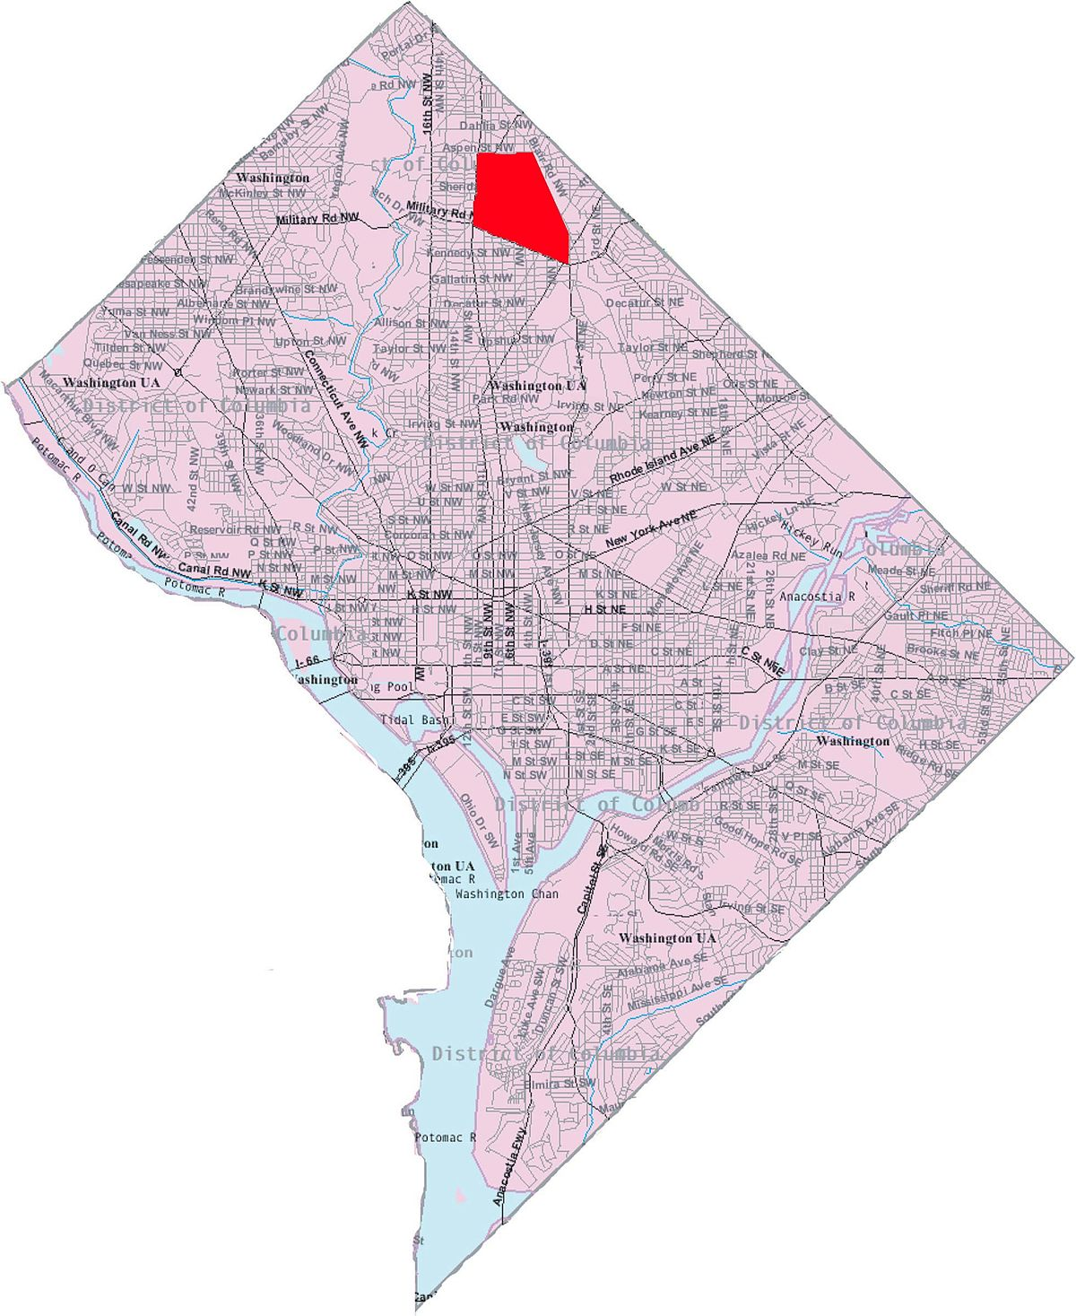
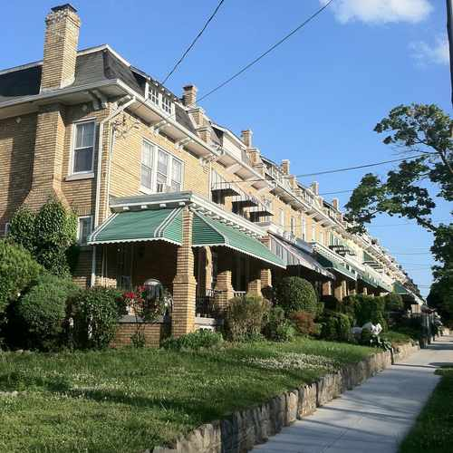
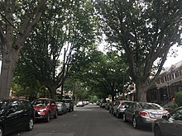
Manor Park DC - My Neighborhood
Notes:
Photo source: https://en.wikipedia.org/wiki/Manor_Park_(Washington,_D.C.)
https://www.walkscore.com/score/6024-8th-st-nw-washington-dc-20011

Slide 3
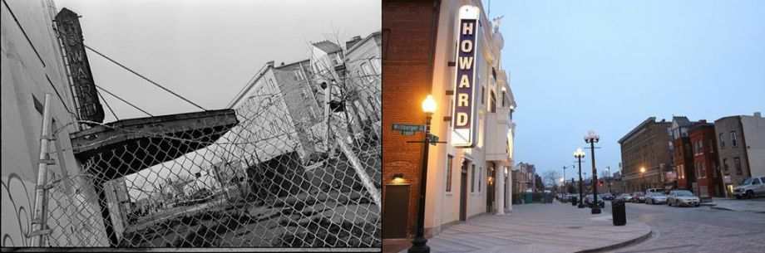
“Chocolate City” No More:
From Segregation and Redlining to Gentrification
“Old” DC
“New” DC
Notes:
Photo source: https://nextcity.org/daily/entry/forefront-excerpt-separate-and-unequal-in-d.c

Slide 4
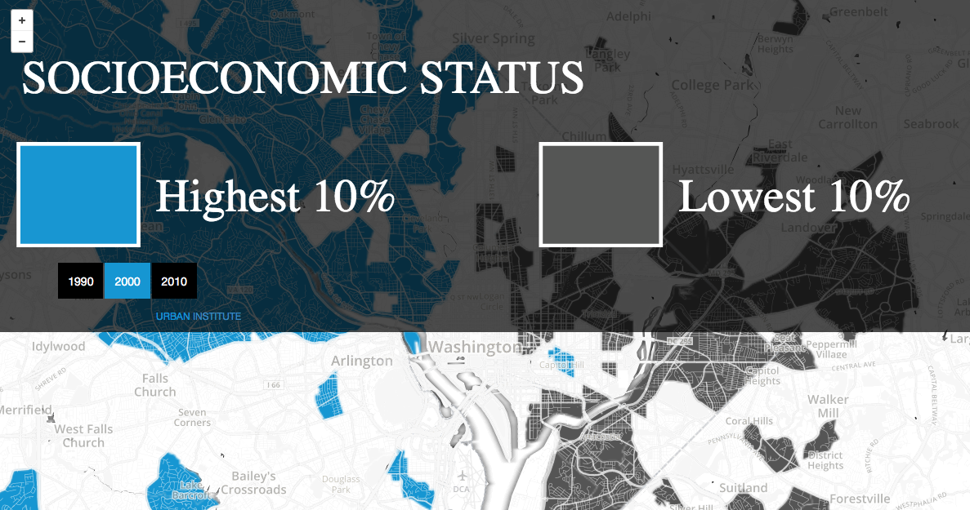
“Mapping the Wealth Divide in Washington, DC”
Click here for interactive map:
http://apps.urban.org/features/ncdb/top-bottom/index.html#11/38.9786/-76.9798

Slide 5
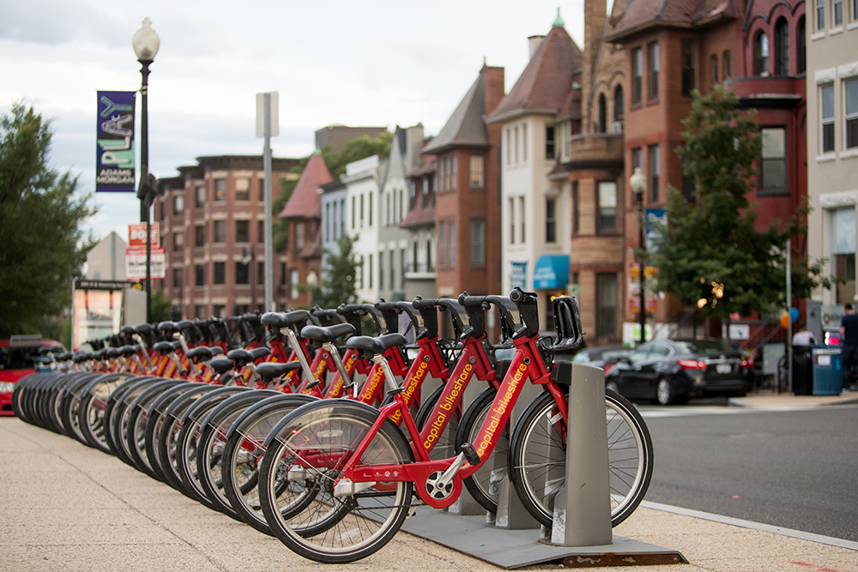


Business Improvement Districts
Community Boon or Bane?
Click here to browse through profiles of DC BIDS: http://static1.1.sqspcdn.com/static/f/1025641/27904554/1525977591060/BID+Profiles+Report+2017.pdf?token=u%2FLV7PBZ8yXXhlsRGKMTQzhx0PU%3D
Notes:
Photo: https://pictures.alignable.com/eyJidWNrZXQiOiJhbGlnbmFibGV3ZWItcHJvZHVjdGlvbiIsImtleSI6ImJ1c2luZXNzZXMvbG9nb3Mvc3F1YXJlLzYzOTI4MS8xNTM3ODE2NzQ1X0FETU9fTG9nb19wYXJ0bmVyc2hpcC5qcGciLCJlZGl0cyI6e319
https://admodc.org/wp-content/uploads/2018/09/AdMo_Placemaking_2018-1016.png
https://www.google.com/url?sa=i&url=http%3A%2F%2Fwww.dcbidcouncil.org%2Fstorage%2Fbid-reports%2FBID%2520Profiles%2520Report%25202017.pdf&psig=AOvVaw0BeqkCy5hL93-qnhf7NPHR&ust=1587110764752000&source=images&cd=vfe&ved=0CAIQjRxqFwoTCLD_kMm-7OgCFQAAAAAdAAAAABAa

Slide 6
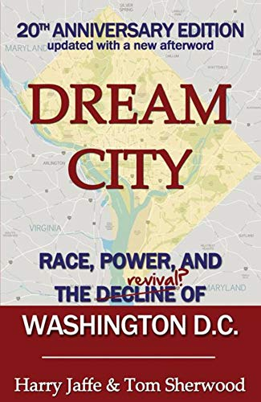
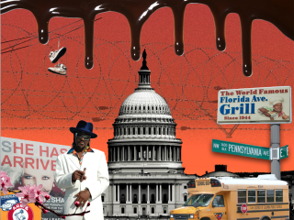
Fading Chocolate City in the “New” DC
Notes:
Photo: https://c1.iggcdn.com/indiegogo-media-prod-cld/image/upload/c_fill,f_auto,h_240,w_320/v1483818419/rmkj1bdaqd7eojjuwevq.jpg
https://images-na.ssl-images-amazon.com/images/I/51D6x2x3wYL.jpg

Slide 7
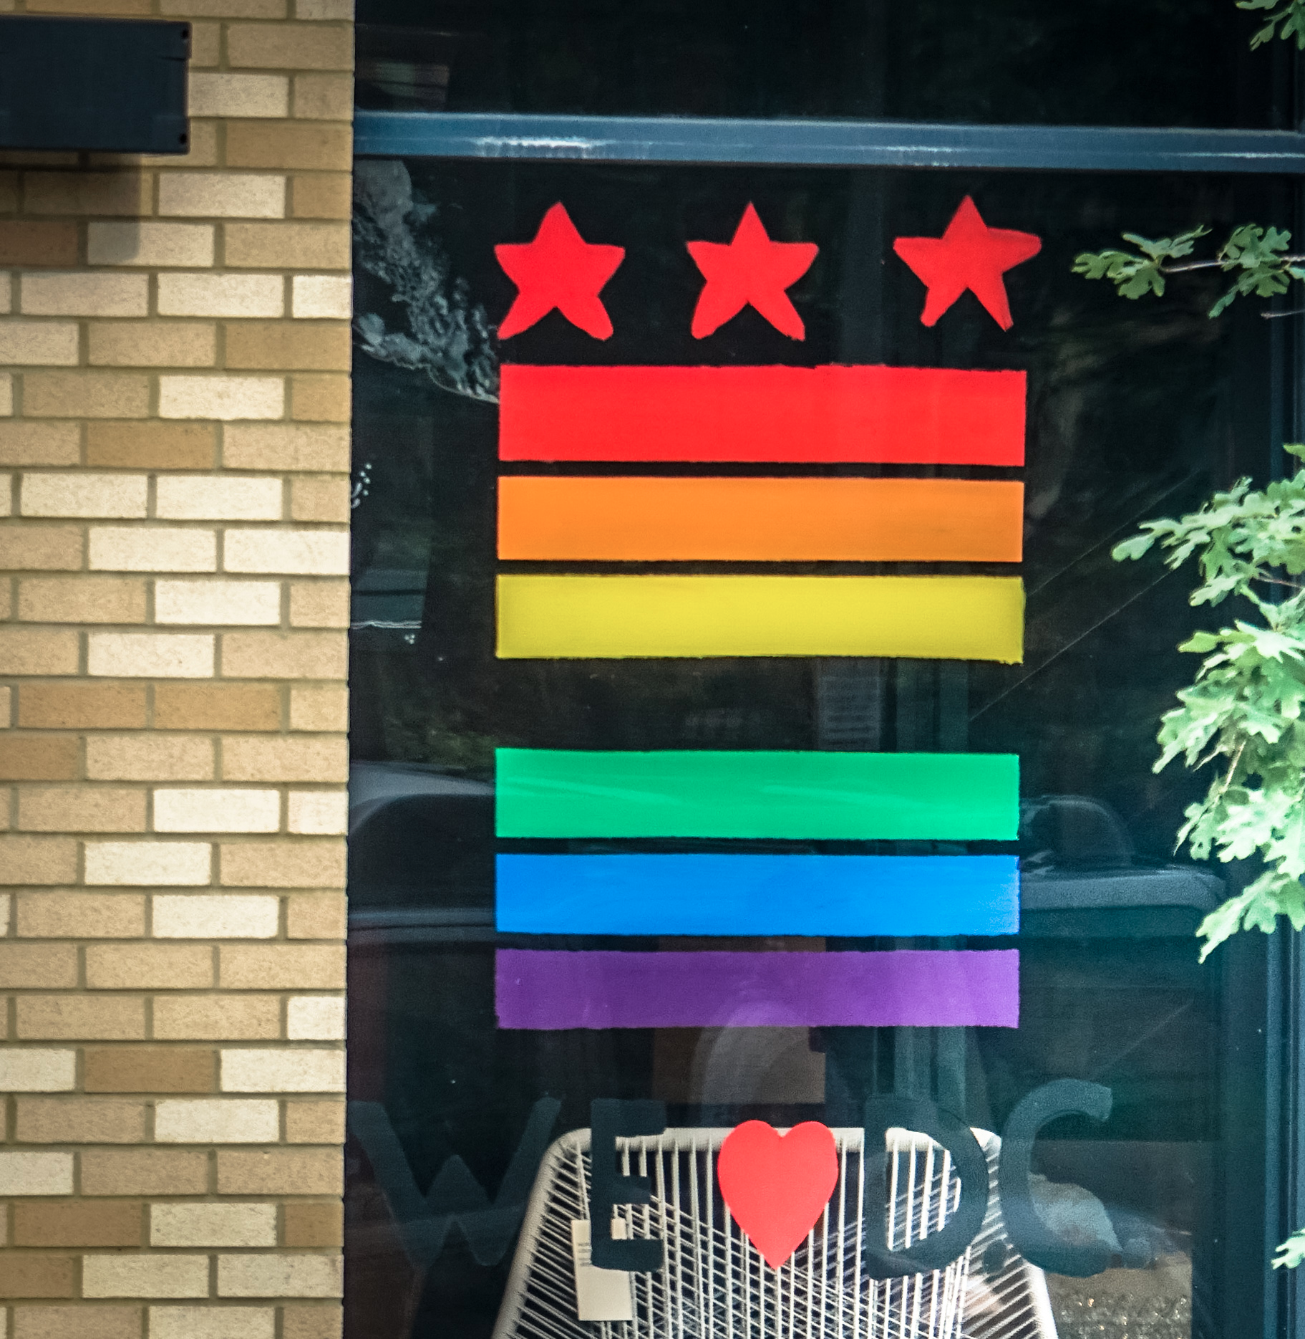
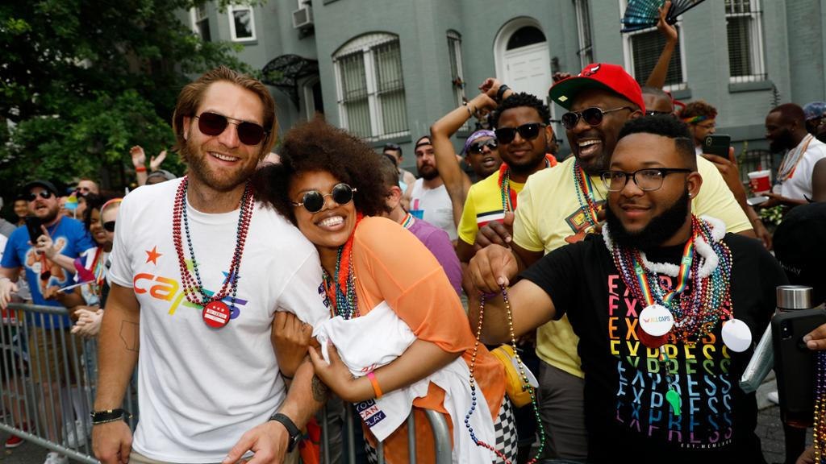
LGBTQ+ DC Community & Culture
Lesbian
Gay
Bisexual
Transgender
Queer/Questioning
Notes:
Photo: https://www.dcpolicycenter.org/wp-content/uploads/2017/06/DC-pride-window.jpg
https://nhl.bamcontent.com/images/photos/307768922/1024x576/cut.jpg

Slide 8
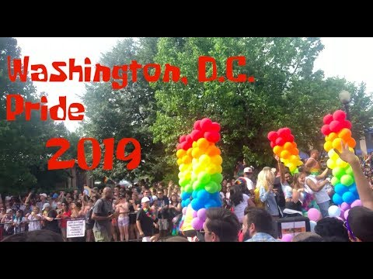
LGBTQ+ DC Community & Culture
As you review these videos, compare these experiences and perspectives to those you’ve read in the articles.
What’s different about the experiences?
Are there any similarities?
Do these reshape your perspectives about life in DC for members of the LBGTQ+ communities?
How do you think race, class, ethnicity, and other factors shape the experiences seen in these videos?

Slide 9
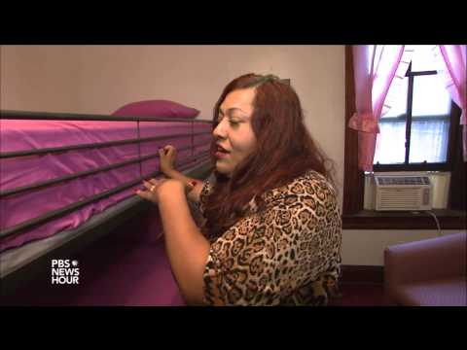
LGBTQ+ DC Community & Culture

Slide 10
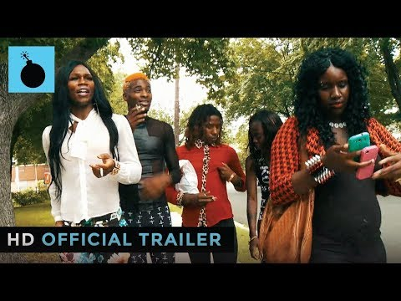
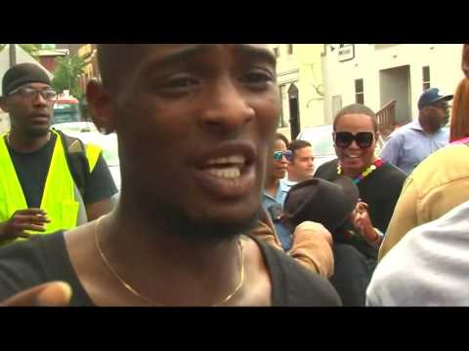
LGBTQ+ DC Community & Culture

Slide 11
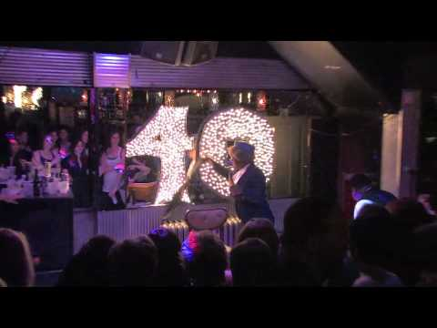
LGBTQ+ DC Community & Culture

Slide 12
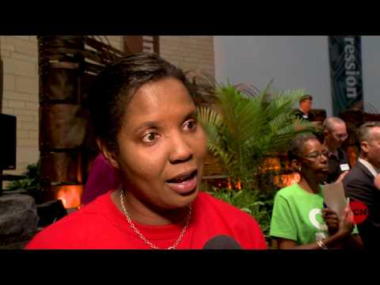
LGBTQ+ DC Community & Culture

Slide 13
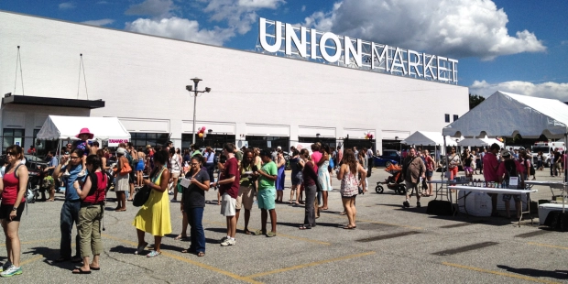
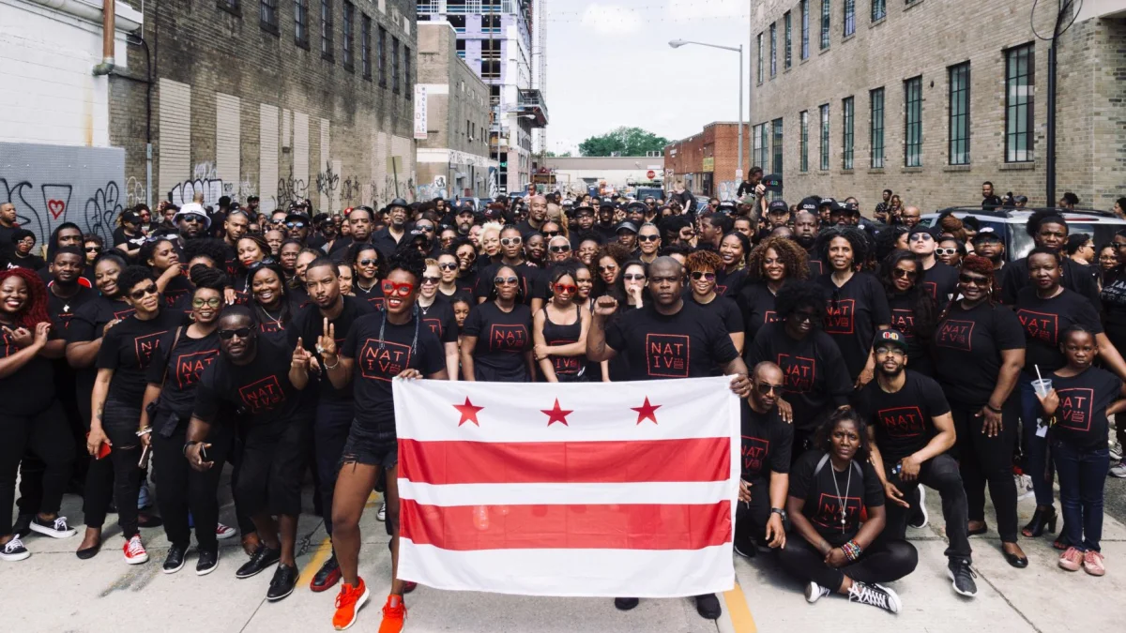
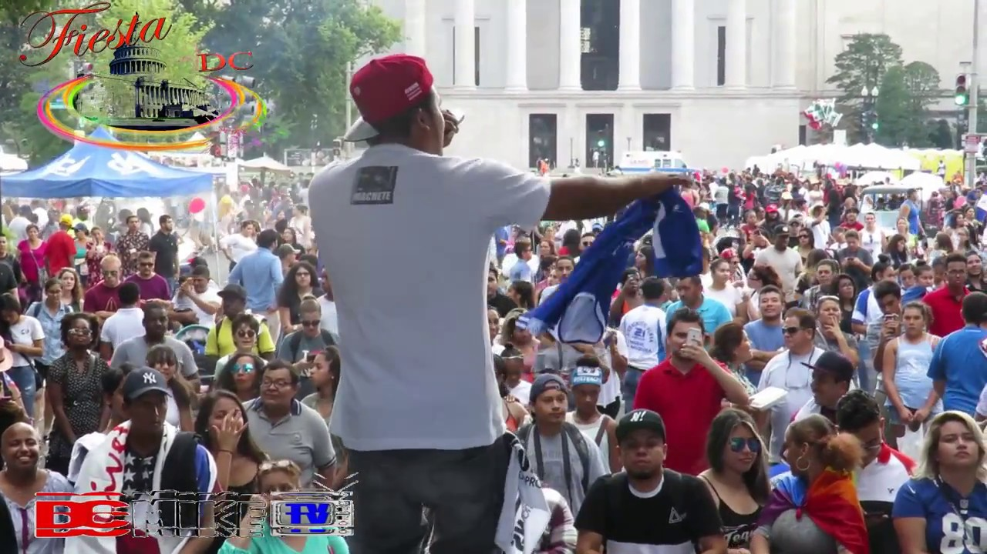
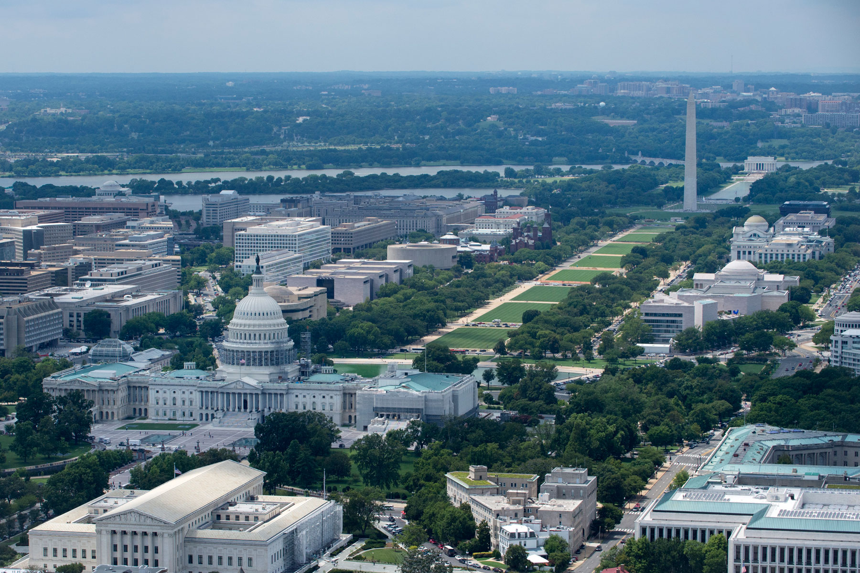
Notes:
https://images03.military.com/sites/default/files/2018-09/washington-dc-aerial-1800.jpg
https://i.kinja-img.com/gawker-media/image/upload/c_fill,f_auto,fl_progressive,g_center,h_675,pg_1,q_80,w_1200/sjnqork4vzwmmjnirsyy.jpg
https://i.ytimg.com/vi/TucL9Nc9ztY/maxresdefault.jpg
https://aleteia.org/2017/04/02/hipster-market-in-dc-to-offer-free-sign-language-class/

